Slide 1
DENGUE FEVER
Dr. Reshma Reghu
Assistant Professor
Dept of Community medicine

Slide 2
ANTHROPOD BORNE INFECTIONS
Dengue syndrome
Malaria
Lymphatic Filariasis

Slide 3
DENGUE SYNDROME
Dengue viruses are arbo- viruses capable of infecting humans, and causing disease.
"classical" dengue fever
(b) dengue haemorrhagic fever without shock
(c) dengue haemorrhagic fever with shock

Slide 5
DENGUE SYNDROME
Dengue fever is a self-limiting disease and represents the majority of cases of dengue infection.
A prevalence of Aedes aegypti and Aedes albopictus together with the circulation of dengue virus of more than one type in any particular area tends to be associated with outbreaks of DHF/DSS.

Slide 6
In India, the risk of dengue has shown an increase in recent years due to rapid urbanization, lifestyle changes and deficient water management including improper water storage practices in urban, peri-urban and rural areas, leading to proliferation of mosquito breeding sites.
The disease has a seasonal pattern i.e. the cases peak after monsoon.

Slide 7
The pathogenesis of severe syndrome involves pre-existing dengue antibody.
It is postulated that virus antibodies are formed within a few days of the second dengue infection and that the non-neutralizing enhancing antibodies promote infection of higher numbers of mononuclear cells, followed by the release of cytokines, vasoactive mediators, and procoagulants, leading to the disseminated intravascular coagulation seen in the haemorrhagic fever syndrome.
All four serotypes have been associated with epidemics of dengue fever (with or without DHF) with varying degree of severity.

Slide 8
VECTOR
Aedes aegypti and Aedes albopictus
They both carry high vectorial competency for dengue virus.
Aedes aegypti is a highly domesticated, strongly anthropophilic, nervous feeder and is a discordant species.
Aedes albopictus partly invades peripheral areas of urban cities. It is an aggressive feeder and concordant species.

Slide 10
Being a domestic breeder, it is a endophagic and endophilic.
Even with a 2°C increase in temperature the extrinsic incubation period of DENV will be shortened and more infected mosquitoes are available for a longer duration.
The mosquitoes will bite more frequently because of dehydration and thus increase man-mosquito contact.

Slide 11
Dengue in the community
A number of factors that contribute to initiation and maintenance of an epidemic include:
(i) the strain of the virus, which may influence the magnitude and duration of the viraemia in humans.
(ii) the density, behaviour and vectorial capacity of the vector population.
(iii) the susceptibility of the human population (both genetic factors and pre-existing immune profile).
(iv) the introduction of the virus into a receptive community.

Slide 12
DF/DHF syndrome
DF/DHF is characterized by the "iceberg" or pyramid phenomenon.
At the base of the pyramid, most of the cases are symptomless, followed by DF,DHF and DSS.
Clusters of cases have been reported in particular households or neighbourhoods due to the feeding behaviour of the vector.

Slide 13
Affected population
The population affected varies from one outbreak to another.
Actual estimates can be made by obtaining clinical/ subdinical ratios during epidemics.

Slide 14
Severity of the disease
The serotype that produces the secondary infection and, in particular, the serotype sequence are important to ascertain the severity of the disease.
All the four serotypes are able to produce DHF cases.
2% to 4% of individuals develop severe disease.

Slide 17
1. Undifferentiated fever
Infants, children and adults who have been infected with dengue virus, especially for the first time may develop a simple fever indistinguishable from other viral infection.
Maculopapular rashes may accompany the fever or may appear during defervescence.
Upper respiratory and gastrointestinal symptoms are common.

Slide 19
1. Febrile phase
Following an incubation period of 4 to 6 days, the illness commonly begins abruptly with high fever accompanied by facial flushing and headache.
Anorexia, vomiting, epigastric discomfort, tenderness at the right costal margin and generalized abdominal pain are common.
During the first few days the illness usually resembles classical DF
Temperature may be 40°C to 41°C and febrile convulsions may occur particularly in infants.
The major pathophysiologic changes that determine the severity of disease in DHF are plasma leakage and abnormal haemostasis, as manifested by a rising haematocrit value and moderate to marked thrombocytopenia.

Slide 22
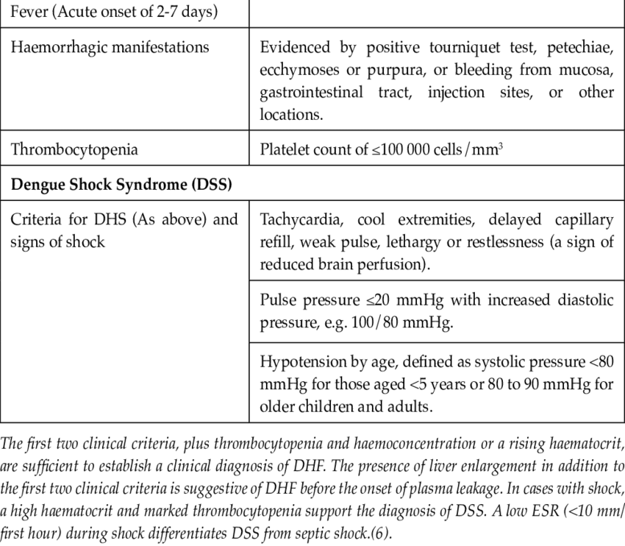

Slide 24
4. Viral antigen detection : ELISA and dot blot assays directed against the envelop/membrane (EM) antigens and nonstructural protein 1 (NSl) can be detected in both patients with primary and secondary dengue infection upto 6 days after the onset of the illness.
5. Rapid diagnostic test (RDT) : serological test-kits for anti-dengue IgM and IgG antibodies producing results within 15 minutes.
6. Analysis of haematological parameters : Standard haematological parameters such as platelet count and haematocrit are important

Slide 25
CLINICAL MANAGEMENT
Grading the severity of the dengue infection

Slide 26
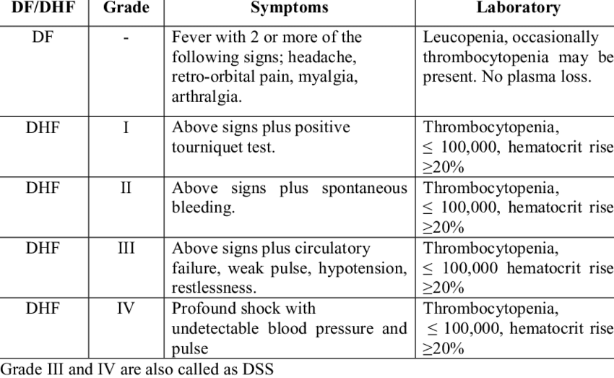

Slide 27
Guidelines for treatment
A full blood count of the patient should be done at the first visit.
A haematocrit test in the early febrile phase establishes the patient's own baseline haematocrit.
A rapidly decreasing platelet count in parallel with a rising haematocrit compared to the baseline is suggestive of progress to the plasma leakage/critical phase of the disease.
In the absence of the patients baseline, age specific population haematocrit levels could be used as a surrogate during the critical phase.

Slide 28
Management of dengue fever
These are patients who are able to tolerate adequate volumes of oral fluids and pass urine at least once every six hours,
Note the platelet count and haematocrit value daily from third day to two days.
Patients should be observed for signs of shock
A rise of haemo- concentration indicates need for IV fluid therapy
Vital signs should be noted
Red cell transfusion
platelet transfusion

Slide 29
CONTROL MEASURES
1. Mosquito control
2. Vaccines
3. Other measures
Isolation of the patient under bed-nets
The personal prophylactic measures are wearing of full sleeves shirts and full pants; use of mosquito repellent creams, liquids, coils, mats etc.; use of bed-nets for sleeping infants and young children during day time to prevent mosquito bite.
The environmental measurements are detection and elimination of mosquito breeding places, management of roof tops, porticos and sunshades, proper covering of stored water, observation of weekly dry day.

Slide 30
Global strategy for dengue prevention and control 2012-2020
The goals are :
a. to reduce dengue mortality by at least 50 per cent by 2020;
b. to reduce dengue morbidity by at least 25 per cent by 2020;
c. to estimate the true burden of the disease by 2015.

Slide 31
Instruct the care-givers that the patient should be brought to hospital immediately if any of the following occur; no clinical improvement, deterioration around the time of defervescence, severe abdominal pain, persistent vomiting, cold and clammy extremities, lethargy or irritability/ restlessness, bleeding (e.g. black stools or coffee-ground vomiting), not passing urine for more than 4-6 hours.
Patients who are sent home should be monitored daily by health care providers for temperature pattern, volume of fluid intake and losses, urine output {volume and frequency), warning signs, signs of plasma leakage and bleeding, haematocrit, and white blood cell and platelet counts.

Slide 32
Management of DHF (Febrile Phase)
Copious amount of fluid should be given orally, to the extent the patient tolerates, oral rehydration solution (ORS), such as those used for the treatment of diarrhoeal diseases and/or fruit juices are preferable to plain water.
IV fluid may be administered if the patient is vomiting persistently or refusing to feed.
Patients should be closely monitored for the initial signs of shock.
The critical period is during the transition from the febrile to the afebrile stage and usually occurs after the third day of illness.
Serial haematocrit determinations are essential guide for treatment, since they reflect the degree of plasma leakage and need for intravenous administration of fluids.
Haematocrit should be determined daily from the third day until the temperature has remained normal for one or two days.

